Slide 1
Nicholas P. Cox, PhD
Program Coordinator &
Professor of U.S. and Texas History
Houston Community College
Fort Bend County Historical Commissioner
Email: nicholas.cox@hccs.edu
Twitter: @npcox

Slide 2
Northern Shoshones of the Great Basin Region

Slide 3
Pre-Spanish Era of Texas Proto-Indians

Slide 4
The Pueblo Revolt 1680

Slide 5
Comancheria

Slide 6
Comanche Raids into Northern Mexico

Slide 7
Joseph Santiesteban, The Destruction of Mission San Saba, Painted 1765

Slide 8
The Ruins of Mission San Saba, Destroyed 1758

Slide 9
Lino Sánchez y Tapia, Comanches, 1830s

Slide 10
Dodge-Leavenworth Expedition, 1834

Slide 11
George Catlin, Comanche Feats of Horsemanship, 1834-1835

Slide 12
George Catlin, Comanche Village, 1834-1835

Slide 13
George Catlin, Comanche, 1834

Slide 14
George Catlin, Two Comanche Girls, 1834

Slide 15
Cynthia Ann Parker, abducted at Fort Parker, 1836

Slide 16
Council House Fight, San Antonio, 1840

Slide 17
Texas Diplomacy, 1841-44

Slide 18
US Army Forts, 1849-1852

Slide 19
US Army Forts, 1852-1861

Slide 20
Medicine Lodge Treaty, 1867

Slide 21
Red River War, 1874

Slide 22
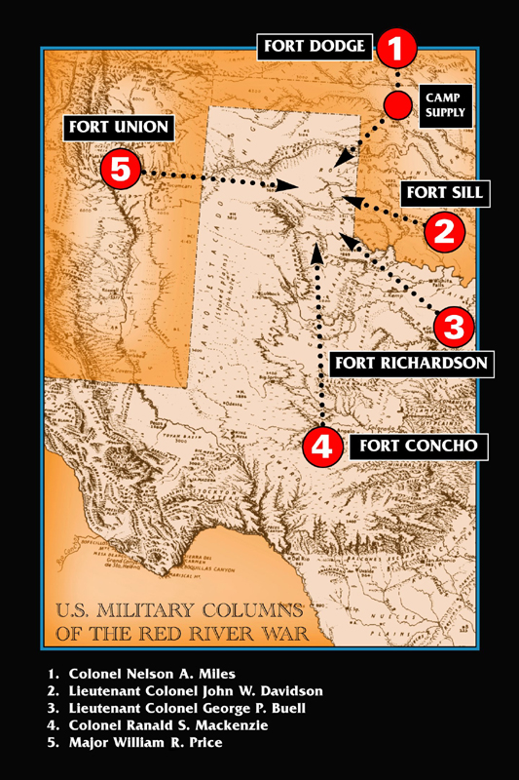
Ranald S. Mackenzie

Slide 23
On the Reservation

Slide 24
Allotment and Dispossession, 1901

Slide 25
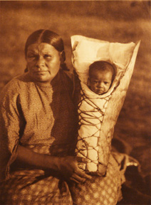
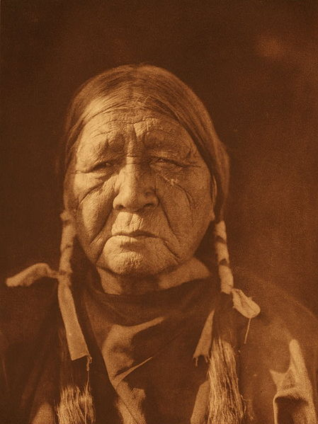
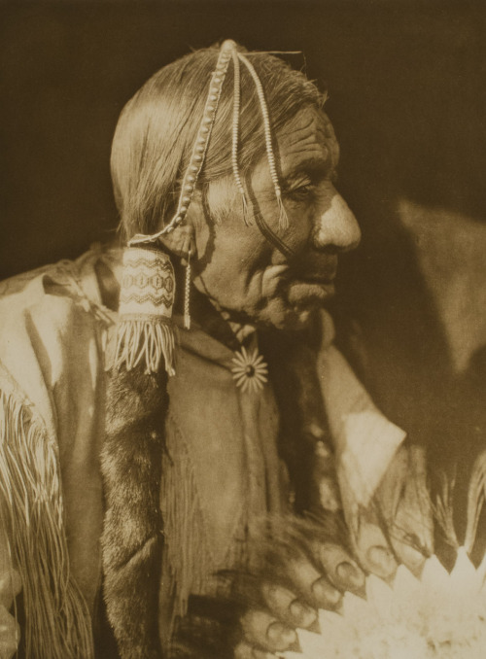
Edward Curtis, Comanche Portraits, 1907-1930

Slide 26
Josefa Roybal, Comanche Dancers, 1930-1939

