Slide 1
Intro to PivotTables
Fulshear Branch Library

Slide 2
What you will learn in this class ...
Understand what PivotTables are used for.
Know how to create a basic PivotTable.
Customize PivotTables.

Slide 3
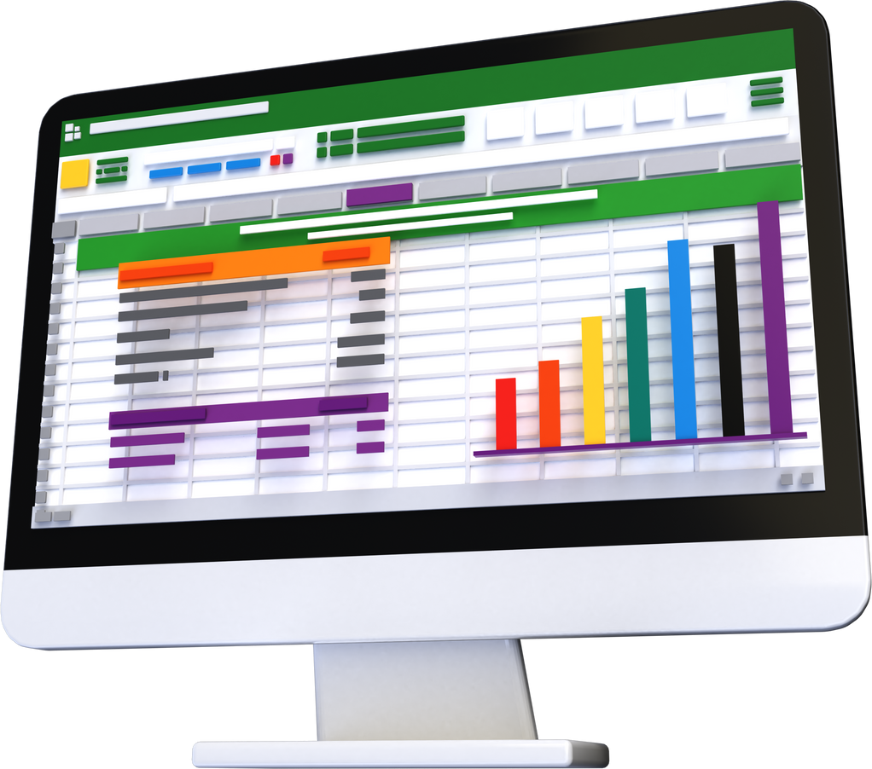
What are PivotTables?
A PivotTable is an interactive tool that summarizes worksheet data.
PivotTables can automatically sort, count, and total spreadsheet data and then create a second table to display the summarized data.

Slide 4
Let's get started!

Slide 5
More Computer Classes
April 2024
Intro to 3D Printing - Wed, Apr. 24 @ 11 AM
May 2024
PowerPoint Basic - Wed, May 1 @ 11 AM
PowerPoint Intermediate- Wed, May 8 @ 11 AM
Drop-In Tech Help - Wed, May 15 @ 11 AM
Accessing Magazines Online with Flipster - Wed, May 22 @ 11 AM

