Slide 1


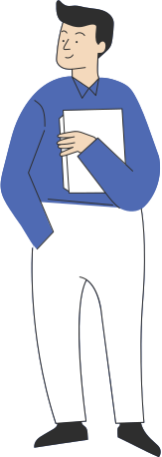

COMPUTER SAFETY

Slide 2
LESSON 1: CREATE STRONG PASSWORDS
Notes:
Use these tips to create a strong, safe password

Slide 3
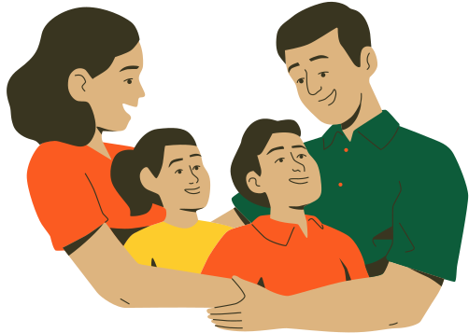
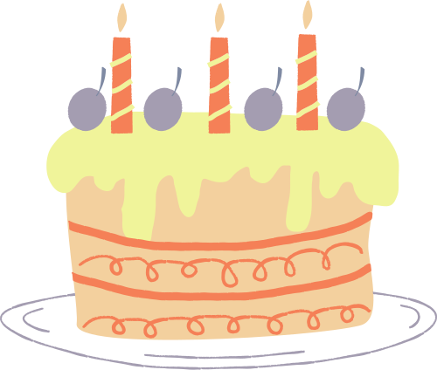
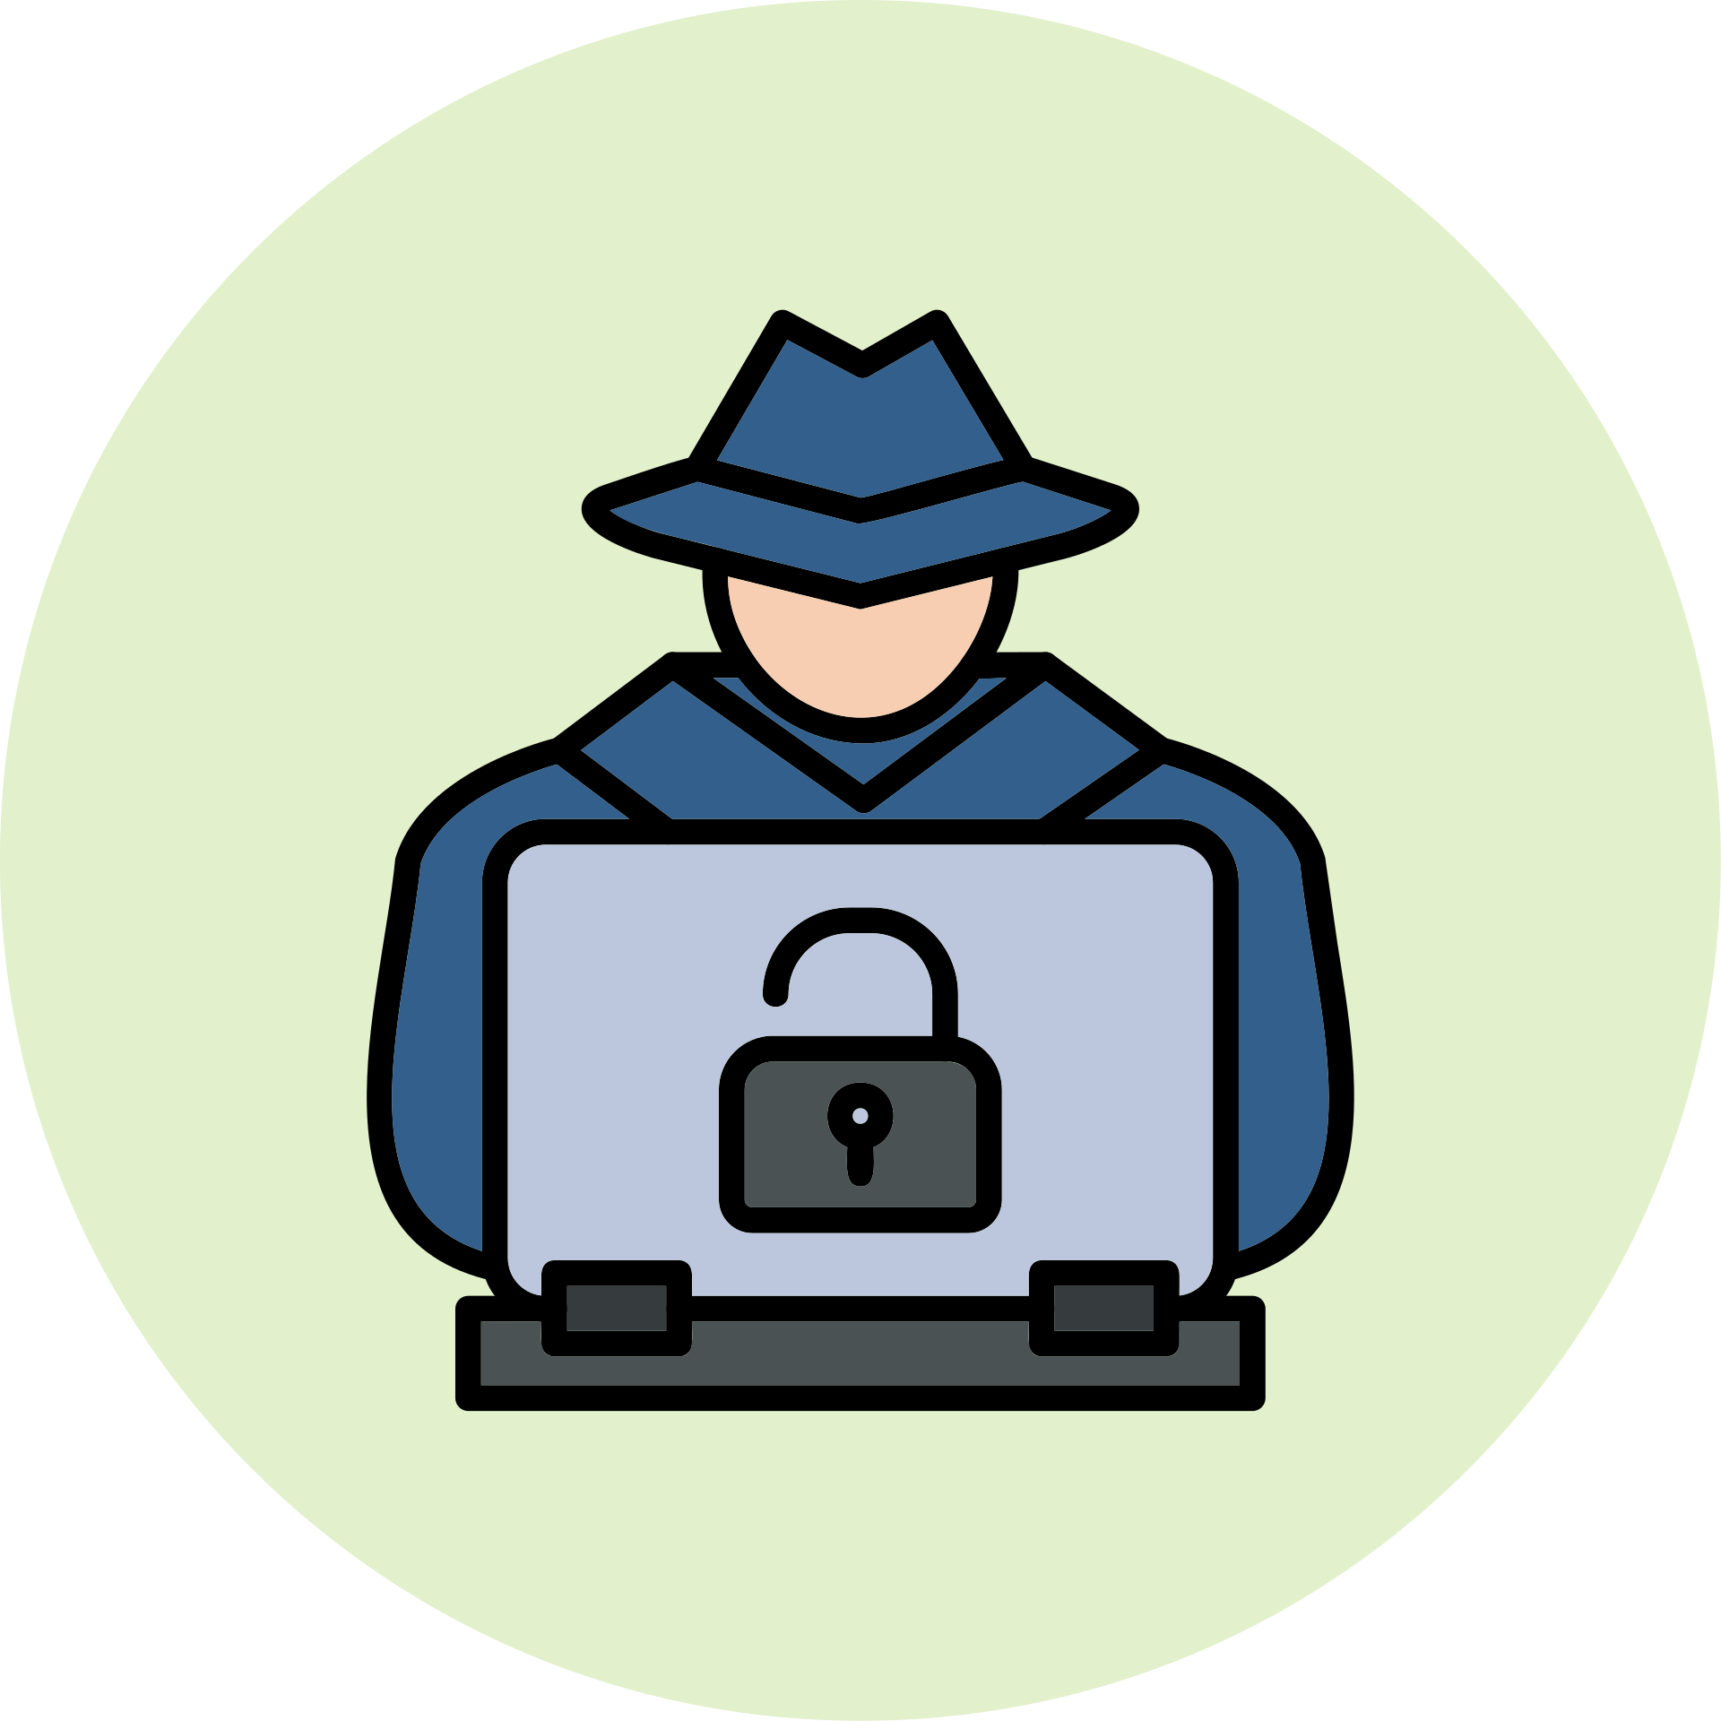
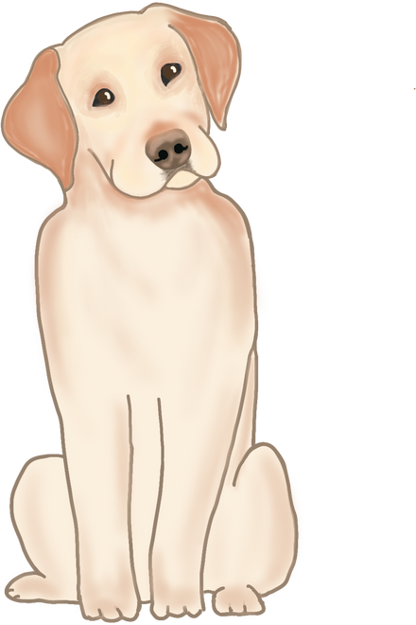
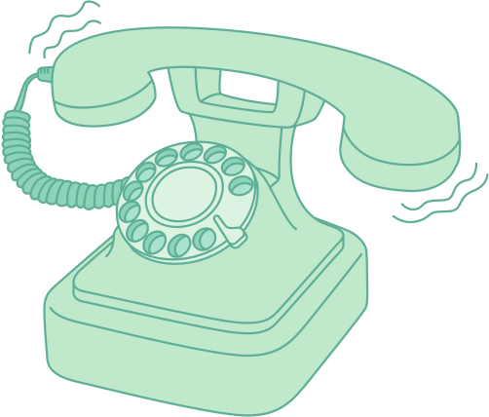
Notes:
Sometimes what stands between you and a cybercriminal is your password. For this reason, you should create strong passwords. Cybercriminals can make guesses or use special programs that could make hundreds of guesses to steal your password.

Slide 4

Notes:
If you use a family name, a pet name, birthday or phone number. I recommend you change them. These are easy to guess.

Slide 5

  Never use personal information
  Use a longer password
  Don't reuse it
  Include numbers, symbols, uppercase letters, and lowercase letters
  Avoid words that can be found in the dictionary
  Use a password generator
TIPS FOR CREATING STRONG PASSWORDS

Slide 6
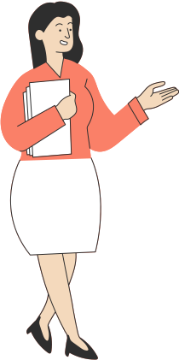
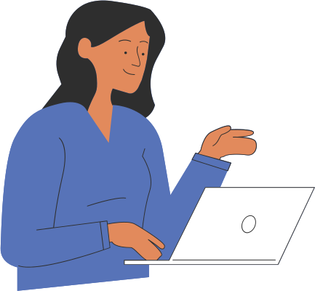
LET'S
SEE SOME EXAMPLES!
Are You Ready?

Slide 7
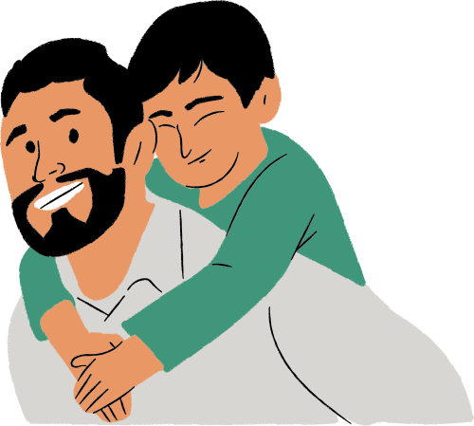
IS THIS PASSWORD STRONG OR NOT?
Password: brian12kate5
"I doubt anyone could guess my password! It's my kids' names and ages. Who else would know that?"
Notes:
Problem: This password uses too much personal information, along with common words that could be found in the dictionary.

Slide 8
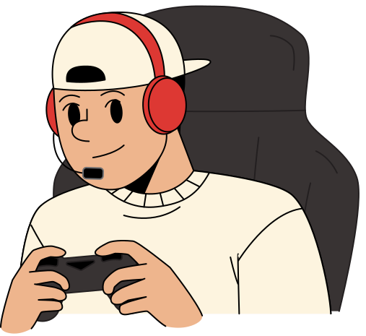
IS THIS PASSWORD STRONG OR NOT?
Password: chEwbAccAp!ZZa
"I combined my favorite character (Chewbacca) with my favorite food (pizza).
Notes:
Strong! It uses symbols, uppercase letters, and random order. Plus, it does not contain family names.

Slide 9
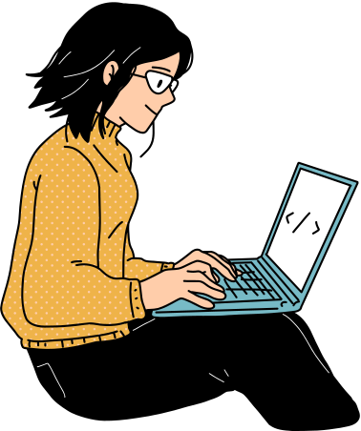
IS THIS PASSWORD STRONG OR NOT?
Password: w3St!
"My password is so simple! It's just the beginning of my street address with a few extra characters."
Notes:
Problem: At only five characters, this password is way too short. It also includes part of her address, which is publicly available information.
Solution: A stronger version of this password would be much longer, ideally more than 10 characters. We could also substitute a nearby street name instead of her current address.

Slide 10
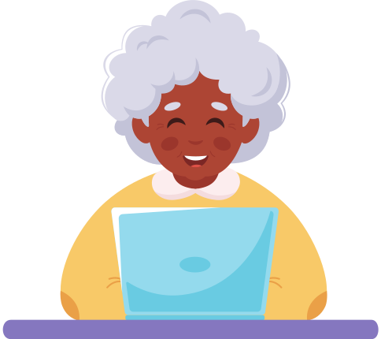
IS THIS PASSWORD STRONG OR NOT?
Password: m#P52s@ap$V
"I use a password generator to create all of my passwords. They're not super easy to remember, but that's OK; I also use a password manager to keep track of them."
Notes:
Password managers can remember and enter your password on different websites, which means you won't have to remember long passwords. Examples of password managers include LastPass, 1Password, and Google Chrome's password manager.

Slide 11
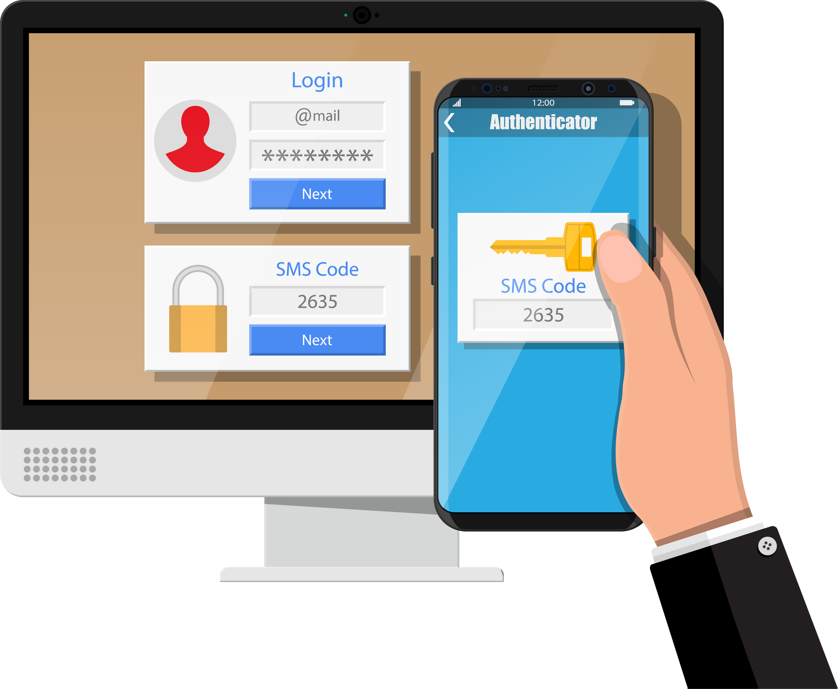
EXTRA TIP
Two Factor Authentication
It is an extra layer of security for your account beyond just a username and password. It requires a token (a second credential), in addition to your password, for you to gain access to your account. Getting that token requires access to something that belongs to you—like your cell phone, email, or fingerprint.
Notes:
Definition: Credentials can be a code sent to your phone, a verification link sent to your email, a notification, etc.

Slide 12
LESSON 2: BROWSER'S SECURITY FEATURES
Notes:
Better understand your browser's security features and how they work.

Slide 13
TIPS FOR SAFE BROWSING
  Check domain names
  Look at the security symbol
  Update your browser regularly

Slide 14
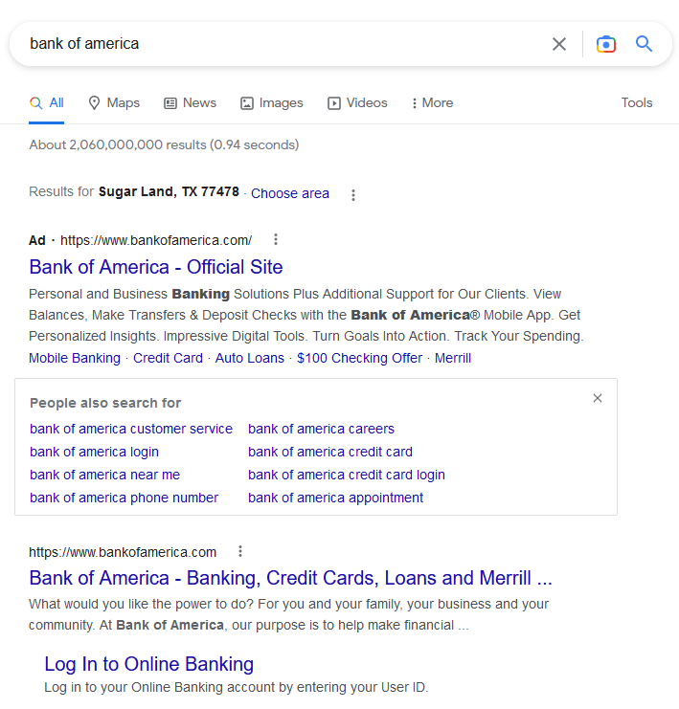
Beware of links that have the Ad symbol.
Carefully, read the domain name
Notes:
Ad symbol: Promoted links might not always be unsafe, but often may try to take advantage of vulnerable people – we have a lot of patrons who’ve accidentally paid for information/forms/etc. that are legally free.
Double-check domain names. Malicious sites often use deceptive website addresses to trick you into believing you are on a legitimate site.

Slide 15
Some websites will display a lock symbol in the address bar. This is most commonly seen with certain types of websites, like online stores and banking sites. This means the website is using an HTTPS connection, which makes it safe to enter your personal information.
Look at the security symbol.
Notes:
You won't see this symbol on all websites, and that's OK—not all websites need this extra layer of security. However, you should avoid entering any sensitive information, such as your credit card number, if you don't see this symbol in the address bar.

Slide 16
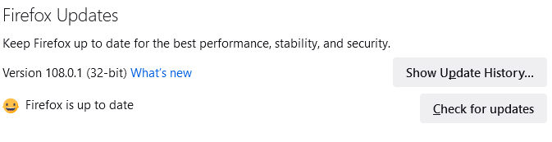
Go to your browser settings to check for any available updates.
Notes:
New viruses and malware are created all the time, so it's important to update your browser regularly. Your browser will usually notify you when it has an update available, but you always have the option to update manually.

Slide 17
LESSON 3: AVOIDING SPAM AND PHISHING
Notes:
Use these tips so you can avoid email-based spam and phishing scams.

Slide 18
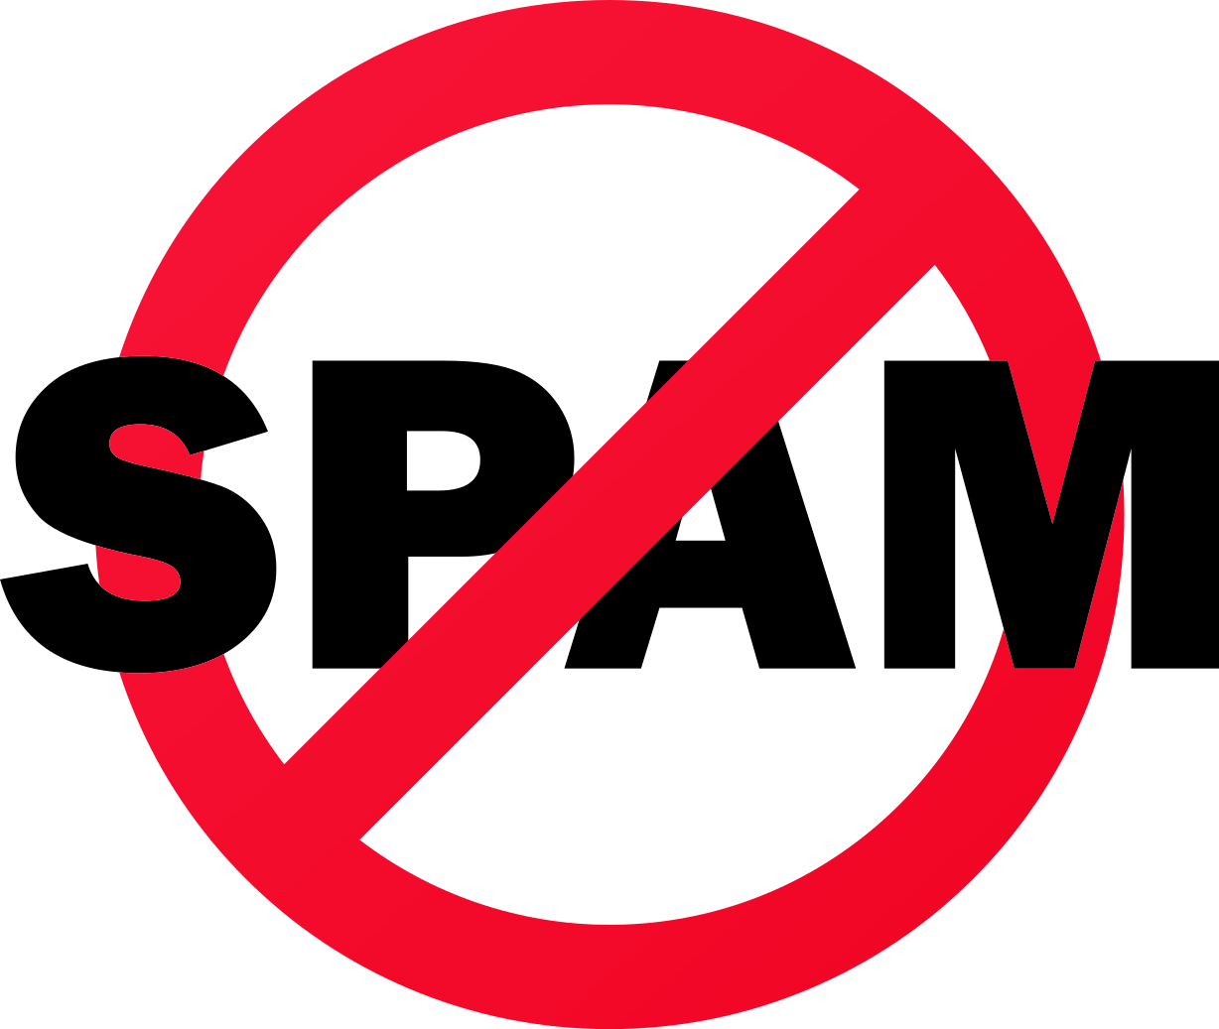
WHAT IS SPAM?
If you've ever received unwanted email advertisements, you may already be familiar with spam, also known as junk email. Spam messages can clutter your inbox and make it more difficult to find the emails you actually want to read. Even worse, spam often includes phishing and malware, which can pose a serious risk to your computer.

Slide 19
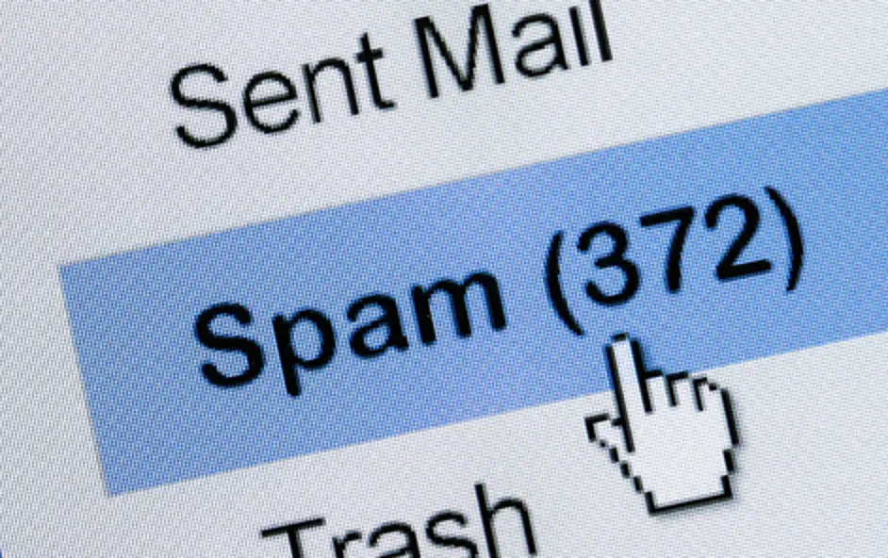
SPAM FILTERS
Whenever you receive an email, most email providers will check to see if it's a real message or spam. Any likely spam messages will be placed in the spam folder so you don’t accidentally open them when checking your email.
Spam-blocking systems aren’t perfect, though, and there may be times when legitimate emails end up in your spam folder.

Slide 20
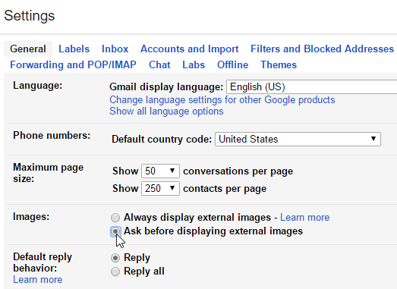
TURN OFF EMAIL IMAGES
Spam messages often contain images that the sender can track. When you open the email, the images will load and the spammer will be able to tell if your email works, which could result in even more spam. You can avoid this by turning off email images.

Slide 21
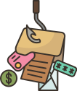
PHISHING
Phishing scams are messages that try to trick you into providing sensitive information. These often appear to come from a bank or another trusted source, and they'll usually want you to re-enter a password, verify a birth date, or confirm a credit card number.
Notes:
Remember phishing attempts can pretend to be governmental agencies, non-profits, or individual friends and family members as well as companies. Also, phishing can happen through private messages on social media, text messages, phone calls, etc.

Slide 22
LET'S
SEE SOME EXAMPLES!
Are You Ready?

Slide 23
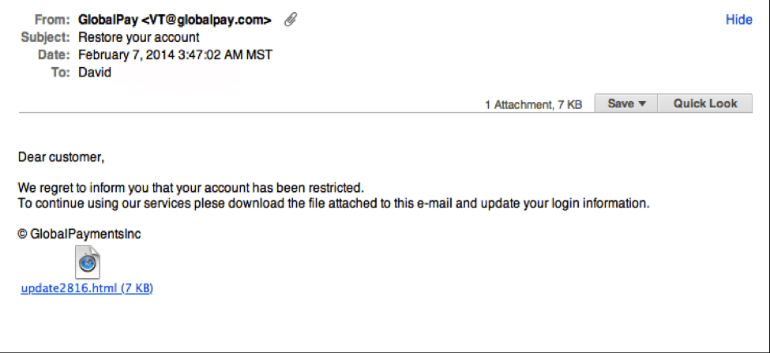
Notes:
Notice the generic salutation at the beginning, and the unsolicited web link attachment?
Look at the time it was sent.

Slide 24
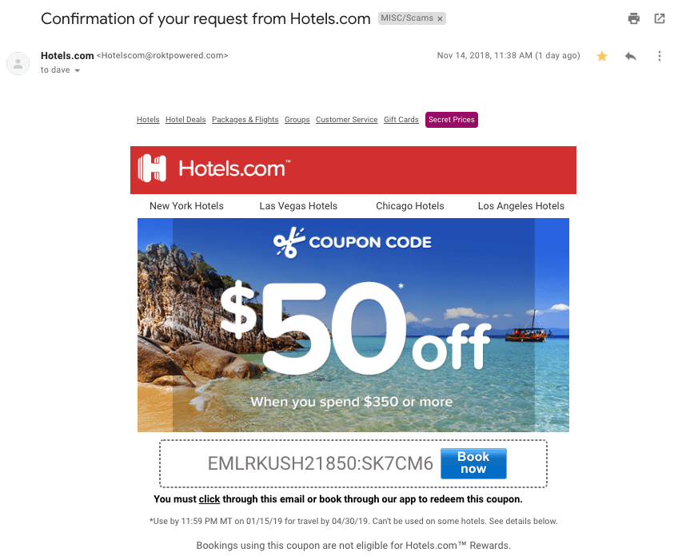
Notes:
This is a very convincing email. For me, the clue was in the email domain. Also the subject line says Confirmation request, but there no information included in the email about it. It is just a coupon code.

Slide 25
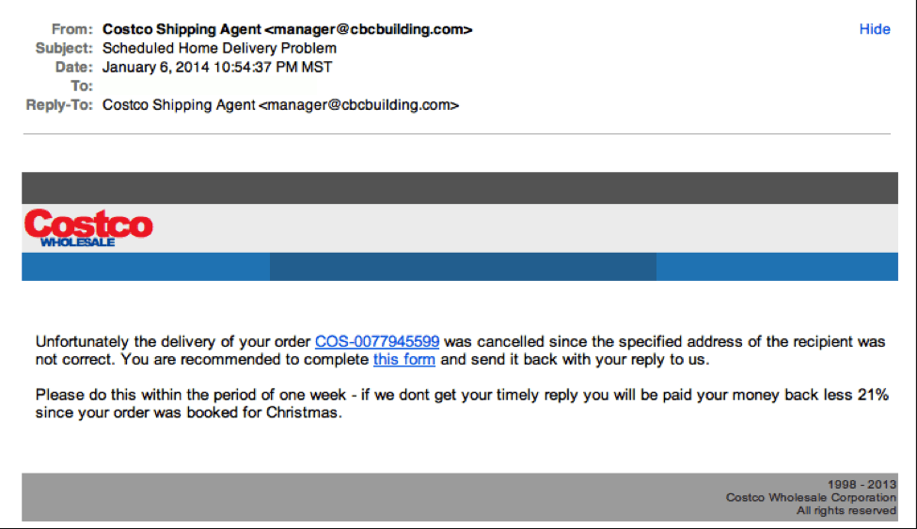
Notes:
"Costco's" logo is just a bit off.
Email domain does not look trustworthy.
Also, did you order anything from Costco?

Slide 26
  Companies don't request sensitive information via email
  Companies call you by your name
  Legit companies have domain emails
  Emails without typos
  Companies don't send unsolicited attachments
  Company links match legitimate URLs
TIPS TO RECOGNIZE A PHISHING EMAIL
Notes:
To verify whether an email is legitimate, call a customer service line or log in to your account through the website.

Slide 27
LESSON 4: HOW TO AVOID MALWARE
Notes:
Learn how to avoid malware and remove it from your computer.

Slide 28
  Run antivirus and antimalware software like Bitdefender or Norton.
  Back up your files
  Avoid suspicious links and clickbait
  Block pop-up windows by default
  Search for information about websites
TIPS TO AVOID MALWARE
Notes:
1. These programs can block malware from being installed and can remove it if it does get onto your computer. Even if you don't see signs of malware on your computer, running regular scans can catch any malware that has escaped notice.
2. Some malware can delete or corrupt data on your drives.
3. Ads on websites can look like system messages or diagnostics warning you that something is wrong with your computer

Slide 29
LESSON 5: SOCIAL MEDIA PRIVACY BASICS
Notes:
Learn all about social media privacy so you can control what you share with others online.

Slide 30
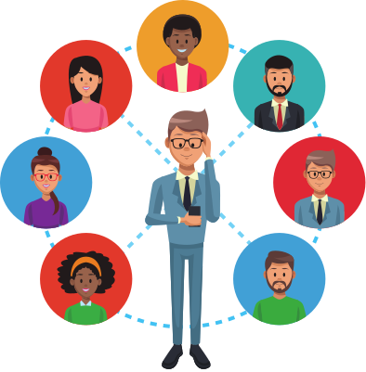
THINK BEFORE YOU SHARE!
Notes:
Whether or not you realize it, the things you share online also can affect how you're perceived by others. That's why you'll always want to think carefully about what you share over social media.
You never know who is looking: your employer, college admission counselor, etc.

Slide 31
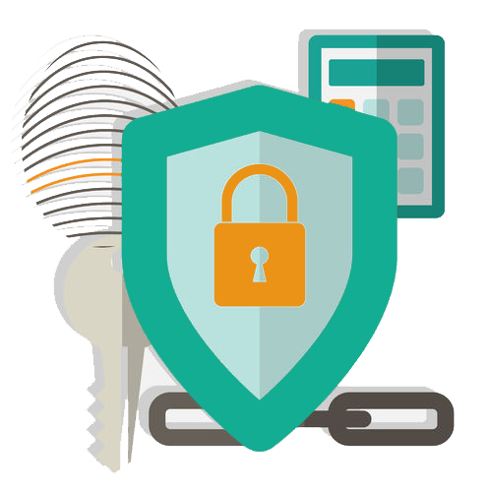
REVIEW PRIVACY SETTINGS
Notes:
Make your accounts private or play with your privacy settings. For example, whenever you share something on Facebook, you can choose to share with just a few people, all of your Facebook friends, or publicly with everyone on Facebook.

Slide 32
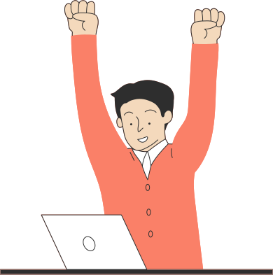
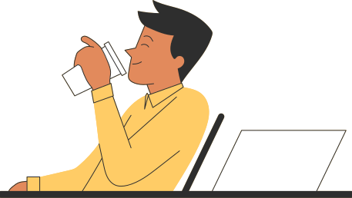
DO YOU HAVE TIPS YOU WOULD LIKE TO SHARE WITH OTHERS?
Notes:
Here's what to do if your computer gets a virus.

Slide 33
Cybersecurity. (n.d.). Internet Safety 101.
Retrieved December 29, 2022, from https://internetsafety101.org/security101-intro
Dashlane. (2022, June 7). 2-Factor Authentication 101: What It Is and Why It Matters. https://blog.dashlane.com/2-factor-authentication-101/
Ellis, D. (n.d). 7 Ways to Recognize a Phishing Email. https://www.securitymetrics.com/blog/7-ways-recognize-phishing-email
GFCGlobal. (n.d.). Internet Safety. https://edu.gcfglobal.org/en/internetsafety/introduction-to-internet-safety/1/
BIBLIOGRAPHY
Notes:
https://us.norton.com/blog/emerging-threats/internet-scams#8

